Slide 1

HOSPITAL BLOOD BANK AUTOMATION SYSTEM STRUCTURED DATA HANDLING USING FILES AND ARRAYS
Team No.10
CSA0219 –C Programming For Logical Thinking
Guided By
Dr.S.K.Saravanan & Dr.A.M.Arul Raj Professor
Institute of Computer Science
SIMATS Engineering
Student names:
Rashmitha (192525034)
Vaishali .S (192525024)
Vishal Balaji Jayashankar(192525014)
Institute of AIML
SIMATS Engineering
1

Slide 2
ABSTRACT
To develop a Blood bank management system.
To reduce Manual record limitations.
To automate works.
To create a File-based data storage.
To display the Web-based output.
To Improve efficiency and accuracy.

Slide 3
Aim and Objective
Automate blood bank operations.
Reduce manual effort.
Improve data handling
Donor data management.
Blood stock tracking.
File handling for data persistence.
Modular C program design.
Web-based report generation.

Slide 4
Introduction
Role in emergency medical care.
Need for accurate blood availability.
Challenges in manual record management.
Requirement for fast data access.
Use of computer-based systems.
Automation in healthcare services.
File-based data storage approach.
Web-based output visualization.

Slide 5
Literature Review & Requirement Analysis
S.No | Year of Publication | Author | Title of the Journal / Book | Methodology Used | Algorithm Used | Key Findings
1 | 2019 | Smith et al. | Blood Bank Management System: A Review | Manual record analysis | None | Manual systems are error-prone and time-consuming
2 | 2021 | Kumar & Rao | Design of Automated Blood Bank Systems | Database-driven automation | Record-based retrieval | Automation improves accuracy but increases cost
3 | 2022 | Lee et al. | Healthcare Information Systems in Hospitals | Centralized data processing | Search and update algorithms | Faster data access and improved efficiency
4 | 2023 | Patel et al. | Web-Based Blood Bank Management System | Cloud-based web architecture | Query-based stock checking | Web systems depend heavily on internet availability

Slide 6
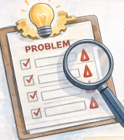
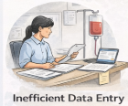


Problem Statement
Manual blood record handling.
Data redundancy.
Human errors.
Slow data retrieval.
Emergency response delays.

Slide 7
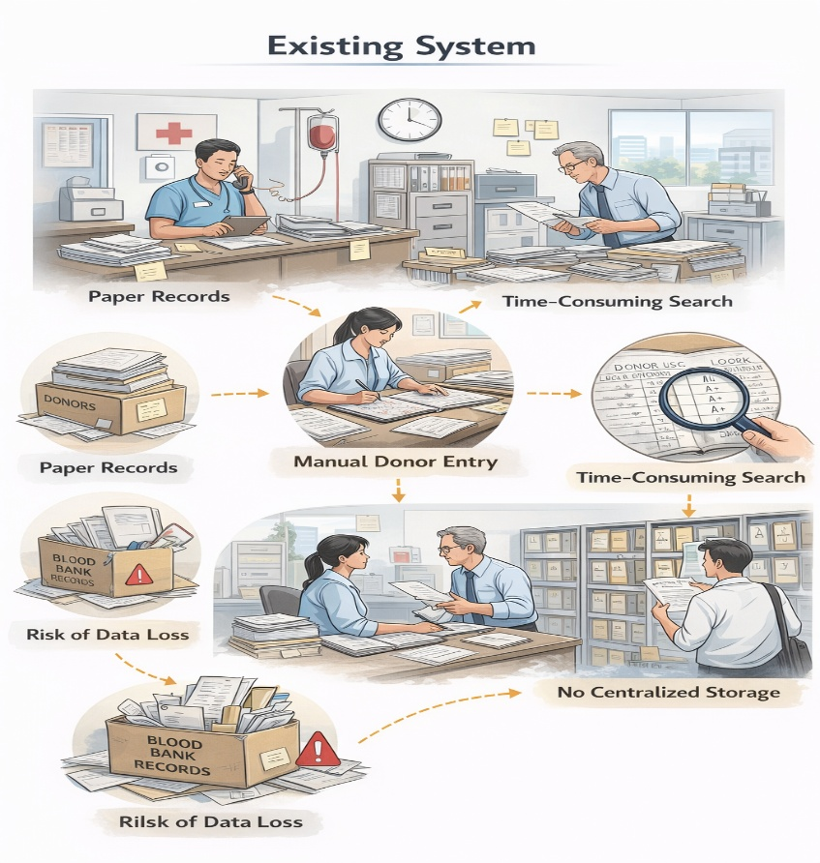
Existing System
Paper-based records.
Manual donor entry.
Time-consuming search.
Risk of data loss.
No centralized storage.

Slide 8
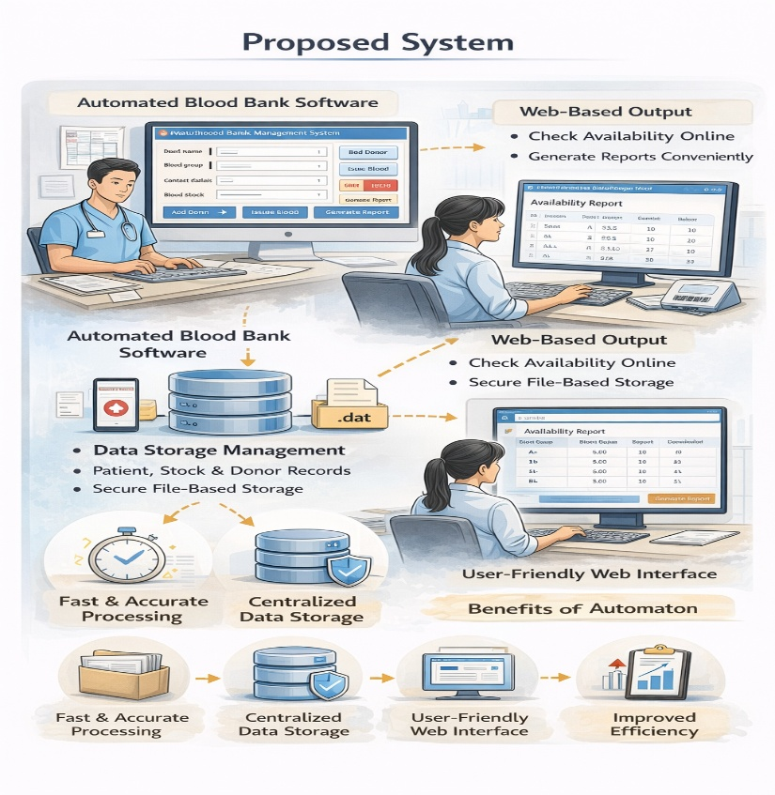
Proposed System
Automated donor registration.
File-based data storage.
Using modular C program.
Web-based output display.
Improved reliability.

Slide 9
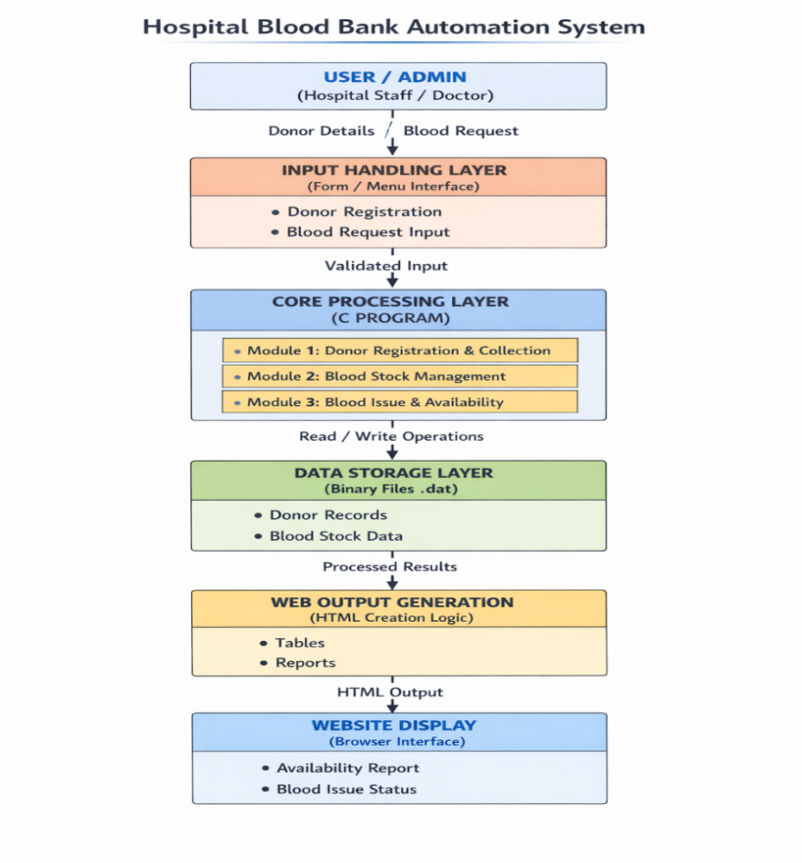
Overall System Architectural Design
User input interface.
C application logic.
File storage system.
HTML output generation.
Browser-based display.

Slide 10
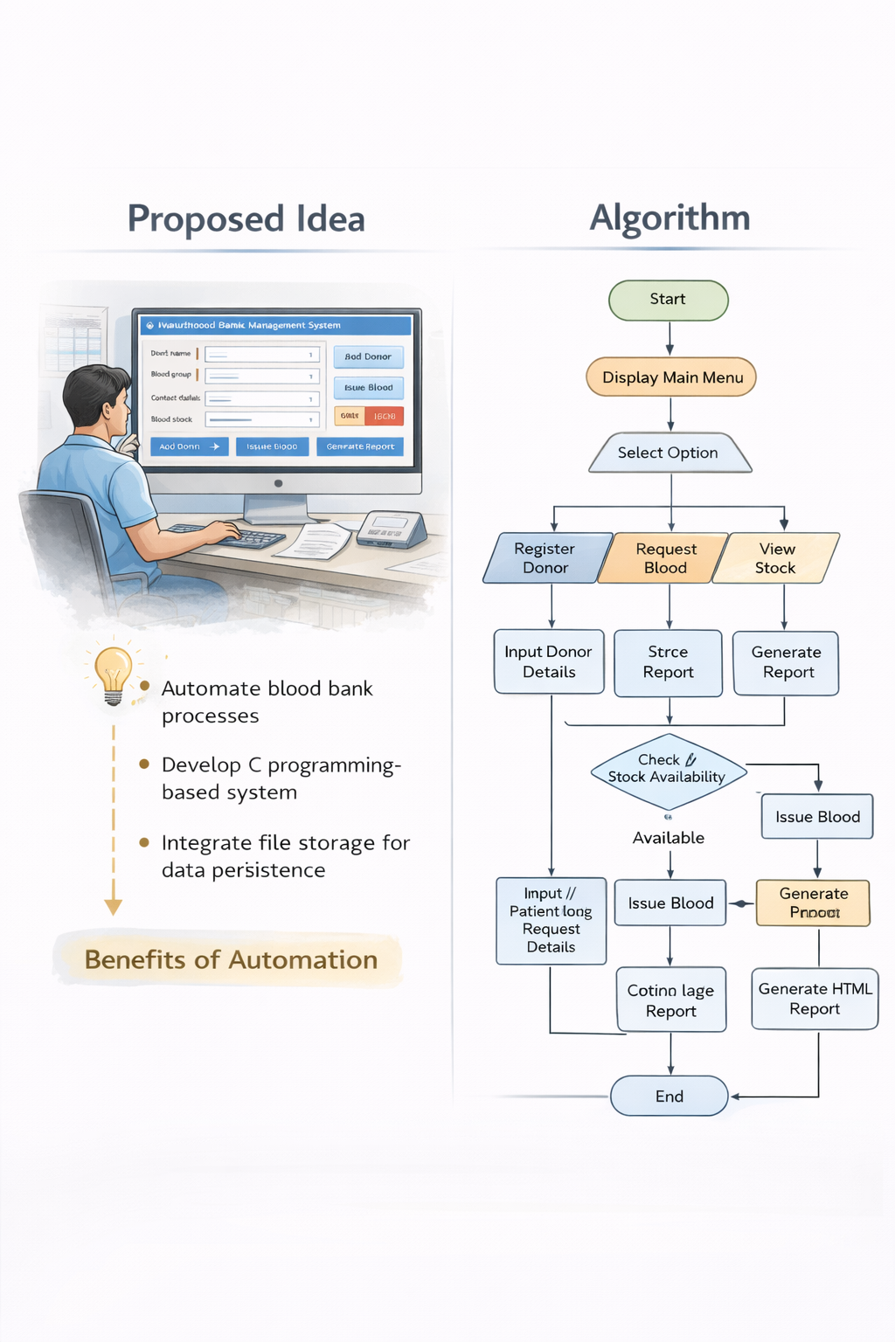
Proposed Methodology and Algorithm
User input validation.
Data processing in C.
File read/write operations.
HTML generation logic.
Output display in browser.

Slide 11


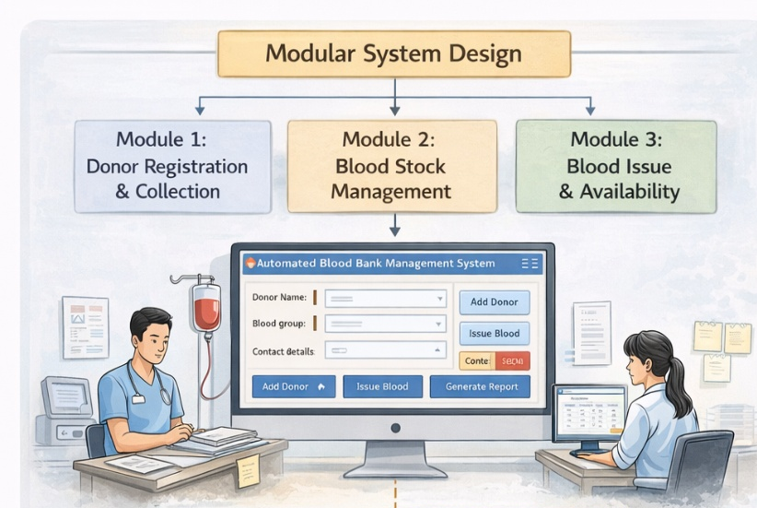
Design & Module Planning
Modular system architecture
Independent functional modules
Easy maintenance
Scalable design
Modules
Donor Registration
Blood Stock Management
Blood Issue & Report

Slide 12
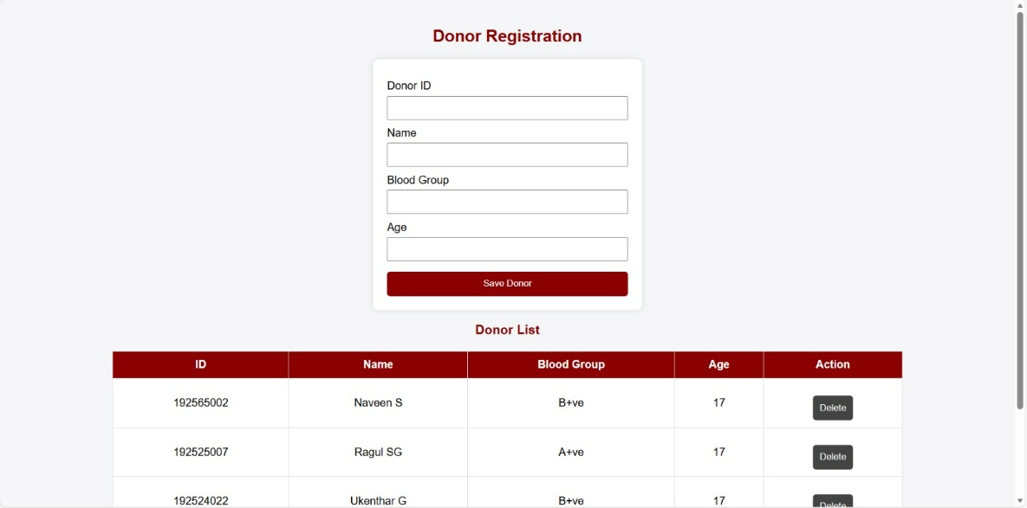
Module 1 – Introduction & Development plan
Donor Registration and Blood Collection Module
Donor information capture
Unique donor ID generation
Blood group identification
Blood unit collection details
Input data validation
Temporary storage using arrays
Permanent storage using files
Successful registration confirmation

Slide 13
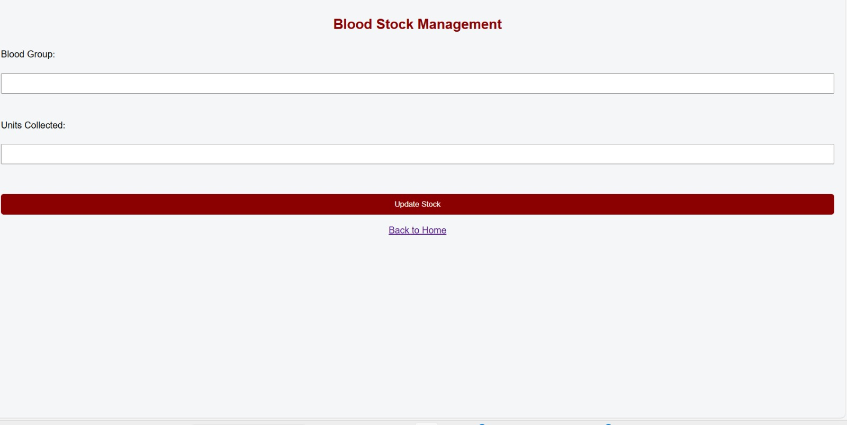
Module 2 – Introduction & Development plan
Blood Stock Management Module
Blood group-wise stock maintenance.
Total units calculation.
Stock update after donation.
Stock update after issue.
File-based data management.
Prevents duplicate records.
Ensures accurate availability.
Quick data retrieval.

Slide 14
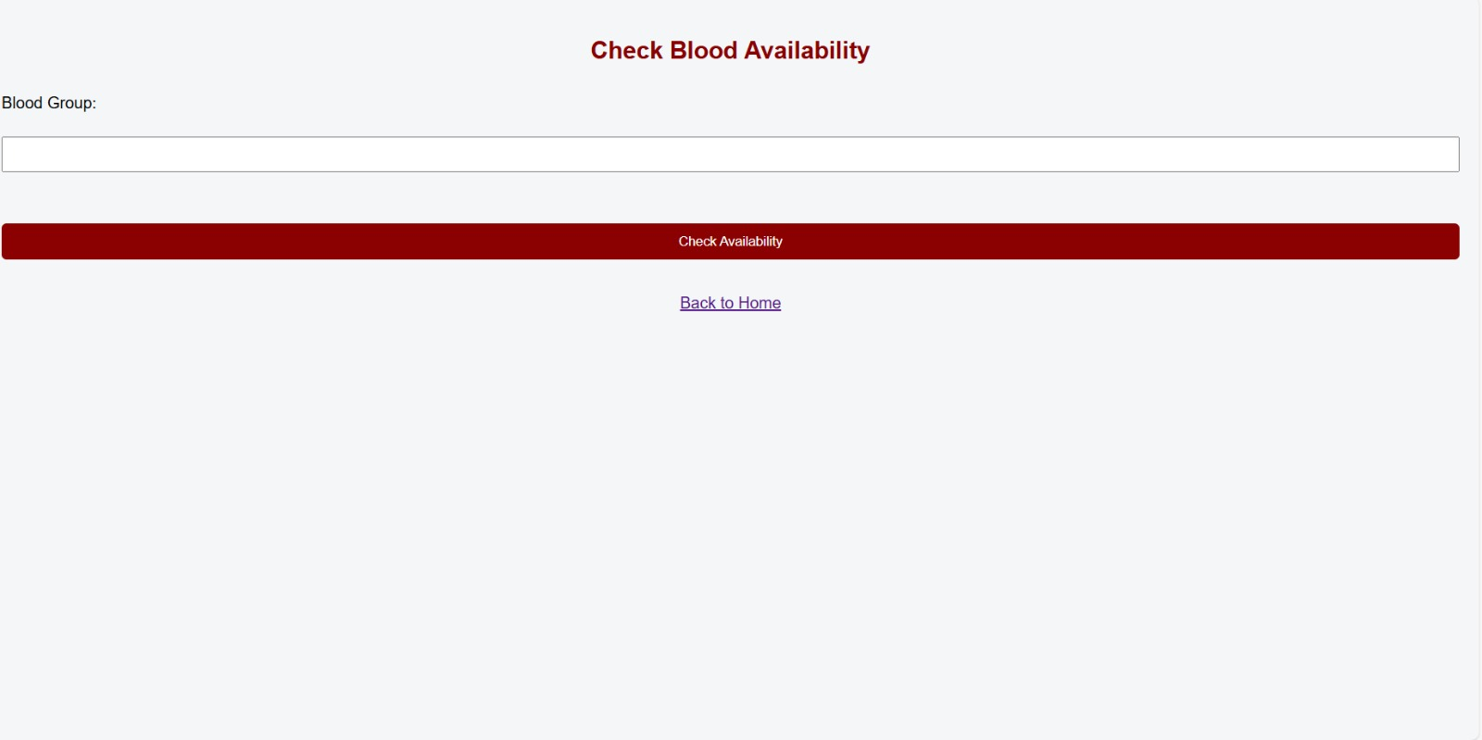
Module 3 – Introduction & Development plan
Blood Issue and Availability Report Module
Blood request processing.
Availability verification.
Blood issue approval logic.
Unit reduction after issue.
Generation of availability report.
Tabular web-based display.
Real-time stock status.
User-friendly output.

Slide 15
Conclusion
Real-world healthcare problem is solved.
Automated solution is implemented.
Efficient data management is done.
Accessibility has been improved.
Scalable system design is developed.

Slide 16
References
Dennis Ritchie – C Programming.
IEEE Healthcare Automation Papers.
Hospital Information System Journals.
Web Technology Documentation.

